Slide 1

Granular Computing for Data Mining
盛艳
2008-06-04

Slide 2

1. GRANULAR COMPUTING
Both new and old
* “granular computing” first suggested in 1997
* various name in many different fields…
Models and methods
* Quotient Space Theory,
* Fuzzy Set Theory,
* Rough Set Theory,
* …

Slide 3
Definition
Granular computing provides a common unifying, conceptual framework for modeling human thinking and problem-solving.
Attempts to extract the commonalities from existing fields to establish a set of generally applicable principles, to synthesize their results into an integrated whole, and to connect fragmentary studies in a unified framework.
Granular computing at philosophical level concerns structured thinking, and at the application level concerns structured problem solving.
While structured thinking provides guidelines and leads naturally to structured problem solving, structured problem solving implements the philosophy of structured thinking.

Slide 4
Granular computing therefore aims at arriving at a new powerful philosophical view and a general problem-solving theory.
The representation concerns granules and their organizations in terms of levels, networks, and hierarchies. One focuses on common features and universally applicable principles for the understanding, description, organization, and formulation of various problems across many different disciplines.
The process deals with (computational) methods that manipulate granules and granular structures. One focuses on practical and systemic methods of problem solving.

Slide 5
三个观点
哲学思想观点：粒计算试图将人类的认知方式抽象化、形式化，从而提炼出结构化的思维模式。
方法论观点：粒计算着重研究系统化的方法和技术，将问题求解的过程规范为结构化的、自上而下的逐步求精过程。
计算模式观点：粒计算关注于结构化的信息处理。信息处理是有层次的，其研究领域涉及抽象的信息处理、人脑中的信息处理及计算机中的信息处理。

Slide 6
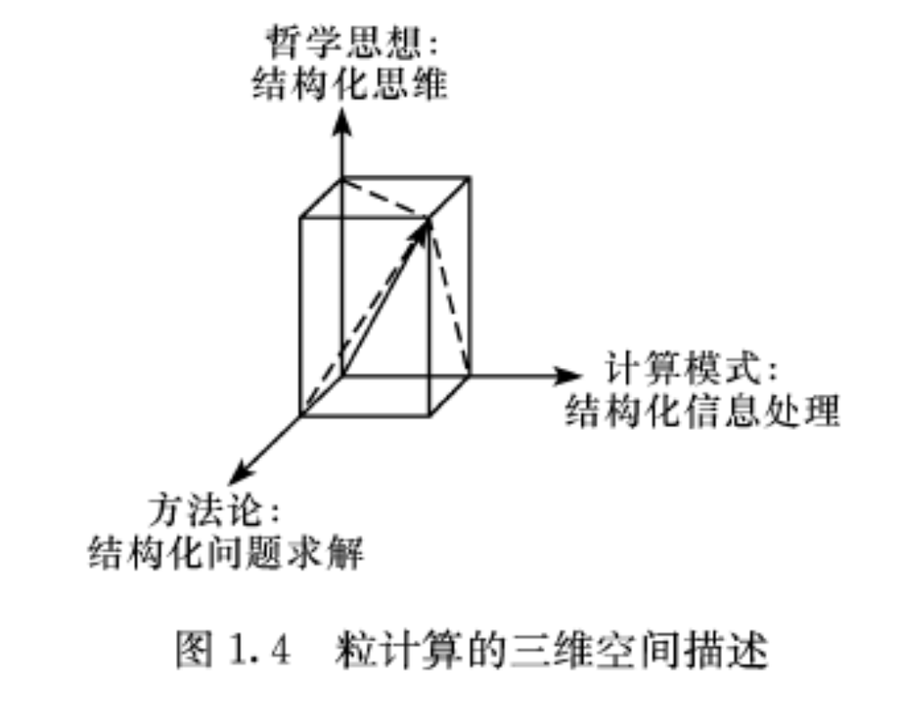

Slide 7
Computational intelligence
Clustering
The theory of hierarchy
Divide and conquer
The theory of small groups
The memory-predication framework of intelligence
…
An underlying assumption of granular computing is that the basic principles and methodologies are common in most types of problem solving, independent of disciplines and problem domains.
such as granule, granulated view, granularity, and hierarchy… may be interpreted in terms of abstraction, generalization, clustering, levels of abstraction, levels of detail, and so on in various domains.

Slide 8
The basic ingredients and issues
Granule
– internal properties reflecting the interaction of elements inside a granule;
– external properties revealing its interaction with other granules;
– contextual properties showing the relative existence of a granule in a particular environment.
Granular structures
– internal structure of a granule;
– collective structure of a family of granules;
– hierarchical structure of a web of granules.

Slide 9
粒与粒结构
粒具有双重身份，其既可以是某个整体的相对独立的一个部分，也可以被看作是由其他一些粒组成的整体。
每个粒具有三个属性：内在属性、外在属性及环境属性。当粒作为一个整体时，考虑其内在属性，粒的内在属性由它所拥有的元素决定。当粒作为一个部分时，考虑其外在属性，粒能够直接被感知、被认识的原因在于其所属的外在属性。粒的环境属性是指它对动态变化的环境的应对方式，对其内在属性、外在属性的保持和调整及对外部环境的影响和回应。
粒的双重身份决定了它的内在属性通常需要强调其所包含细小个体的不同特性，通常是对它内部各个基本组成成分性质的描述，而外在属性需要强调它作为一个整体的综合特性。

Slide 10
Granulation: Granulation involves the construction of the basic components of granular computing, namely, granules, granulated views, web of granules, and hierarchies.
– granulation criteria;
– granulation algorithms/methods;
– representation/description of granules and granular structures;
– qualitative/quantitative characterization of granule and granular structures.

Slide 11
Computing with granules: Computationally, granular computing can solve a problem by systematically exploring the granular structures. This involves two way communications upwards and downwards in a hierarchy and moving within a hierarchy.
– mappings connecting granules and levels;
– granularity conversion;
– operators of computing;
– property preservation or invariant properties.

Slide 12
2. GRANULAR COMPUTING AS A BASIS FOR DATAMINING
Data mining aims at discovering knowledge embedded in data.
Rules are one of the most commonly used knowledge representation methods.

Slide 13
A new framework
In building a granular computing based framework of data mining, we adopt the following assumptions:
Knowledge granule: Each granule represents a piece of knowledge.
Structural knowledge: Connections between a web of knowledge granules represents structural knowledge.
Mining task: Searching for meaningful knowledge granules and structural knowledge is a basic task of data mining.

Slide 14
Knowledge granules
Concepts are the basic units of thought that underlie human intelligence and communication. The classical view treats concepts as entities with well defined borderline and describable by sets of singly necessary and jointly sufficient conditions.
Adopt the classical view of concepts, in which every concept is understood as a unit of thought that consists of two parts, the intension and the extension of the concept.
For data mining, extensions of concepts are normally defined with respect to a particular training set of examples. In this case, we need to consider additional problems such as the definability of granules and the approximation of undefinable granules.

Slide 15
Structural knowledge
Human knowledge is conceptual and forms an integrated whole.
Context and hierarchy.
Structural knowledge can be expressed in terms of connections between a web of knowledge granules.
The granular structures provide a plausible way to describe structural knowledge. Reasoning about intensions is based on logic.
For data mining, we need to derive relationships between the intensions of concepts based on the relations between the extensions of concepts. Through the connections between extensions of concepts, one may establish relationships between concepts.

Slide 16
Mining task
Conceptually, knowledge hidden in a dataset is embedded in the entire knowledge space defined by using only intensions of concepts. The mining task is therefore to search for the most suitable knowledge granules and structural knowledge.
In order to have practical algorithms, we need to have a search space with manageable size. For example, we can search in the space of conjunctively definable concepts. We also need to study search heuristics.
Following our discussion of granular computing, we need to have a multiple view approach for data mining. For example, two types of structural knowledge are formal concept lattices and hierarchical classes.

Slide 17
Three in all
By considering three basic issues, namely, knowledge granules, structural knowledge, and mining task, the new framework may provide a basis for data mining. Instead of dealing with irrelevant details, the framework offers a powerful conceptual view. It will not be a difficult job to interpret existing models of data mining in this framework.
Once the basic concepts, ideas, and principles of granular computing are well understood, their applications to data mining seem to be very straightforward.

Slide 18
3. CONCLUSIONS AND REMARKS
Granular computing
The application of granular computing for data mining illustrates two points. For one, granular computing is indeed a powerful view that can be used to model many problems. For the other, data mining follows the principles of granular computing.
The new framework of datamining focuses on high conceptual level issues by ignoring much irrelevant details. It brings more insights into data mining as a scientific field of study. The three fundamental assumptions, namely, (a) granules as knowledge granules, (b) granular structures as structural knowledge, and (c) mining as search, seem to be reasonable.Those assumptions are in fact implicitly used by many data mining models.

Slide 19
Thanks for your attention!

Slide 22
研究原因
一致性：现实世界充满了结构和层次。粒计算的结构和现实世界的结构、人们的思维模式及行为方式是一致的。
系统性：对所解决的问题多视角、多层次的理解、概括和操作。作为一个整体，粒计算提供的思维模式和行为方式是系统的、完整的。
简化性：提倡对问题进行不同层次的抽象和处理。在抽象过程中，可以只重视主要特性而忽略不相关的细节，达到对问题的简化。
灵活性：粒计算的结构允许人们在不同的时间、不同的情况下，将注意力集中在不同的层次及层与层之间的自然过渡上，缩放和转承是灵活多变的。
有效性：用粒计算指导的思维模式和行为方式将复杂问题分解成若干个小问题。分而治之。
经济性：粒计算寻求在不同粒度上的近似解。提高效率、降低成本。
容忍性：通过使用不同信息粒度，粒计算可以容忍不确定、不完全或有噪音的信息，从而获得具有鲁棒性的解决方案。

Slide 23
将隐式的结构显示化
将不明显的原理明显化
将特定领域的特殊原理普遍化
将下意识的行为变成有意识的行为
通过粒结构将知识和系统合为一体。So，人们能将普遍适用的粒计算哲学有意识地运用到各自面对的问题中去，从而对问题进行更有效的求解。同时，对高层次的粒结构的认识可以防止人们对相同、相似理论和方法的重复发现和发明，避免浪费精力。

Slide 24
不同领域的相同结构和策略
概念形成及学习
粒化及聚类
社会网络
结构化程序
数学证明
…
客观世界可以用不同粒度的结构来有效描述。因此，人们对世界及实际问题的理解和解决是粒化和多层次的；知识结构是粒化和多层次的；用来交流知识的自然语言也是粒化和多层次的。

Slide 25
层次
粒存在于特定的层次中，它们是该层次上研究的主体。在粒计算的不同层次中研究不同类型的粒，这些粒之间是有联系的，同一层次的粒与粒之间可以是不相交的关系，也可以是交叠的关系。
层次中每一个粒表述了一个特定的粒化观点。同一层次的所有粒形成了对此层次的覆盖。所有的粒化观点相互补充、相互呼应，完整表达了在这个层次上对一个问题的描述。
每个层次同样具有内在属性、外在属性及环境属性。
同一层次的粒的属性共同体现了本层次的特性，处在不同层次之间的粒按照序关系排列，相互连接在一起。

Slide 26
在描述一个具体系统或者解决一个具体问题时，考虑：
层次是由什么产生的？
需要多少个层次？
为什么层次是离散的？
什么将层次分割开来？
什么将层次连接在一起？
层次之间如何交互？
这些问题，如果不以某一个具体的系统为背景或结合某个领域的知识，是无法给出令人满意的答案的。

Slide 27
讨论抽象层次的一些共性：
层次的抽象性。抽象是分层次的，对现实世界问题的理解粒度也是分层次的，不同的抽象层次可以表述不同粒度的粒化观点。
层次的约简性。约简问题涉及哲学中的还原论。它指出，如果想到完全地理解和解释一个现象，可以首先将其简化为若干个组成部分或者更为基础的要素，通过对这些组成部分和要素的理解来获得对整体的理解。约简将处于较高层次实体的规则派生到与它邻近的处于较低层次的实体上。
层次的控制性。在很多社会系统及其分层结构中，每个层次对它的下属层次具有控制性。粒计算所研究的层次也具有控制性。较高层次控制较低层次，而较低层次受控于较高层次。
层次的细节性。细节。
较高层次包含较低层次，或者有较低层次组成。较高层次为较低层次提供背景和约束。较高层次一般由具有较高集成度和较高结合力的粒组成。每一个层次都存在某种程度上的独立性。任意两个层次之间的连接和交互式通过偏序关系的传递性和桥接原理来表示和体现。

Slide 28
分层结构
分层结构由若干个层次组成，层次间的递进反映了由表及里、由抽象到具体、由粗糙到细致、由笼统到具体的变化。
高层次，低层次。

Slide 29
粒结构——多层次和多个分层结构的结合
序关系

Slide 30
